Slide 1



Introduction to automated image resizing with Node.js, AWS Lambda, and S3
In this presentation, we'll explore a powerful approach to automating image resizing using Node.js, AWS Lambda, and Amazon S3. By leveraging these cutting-edge technologies, you can streamline your image processing workflows and deliver optimized media to your users with ease.
AS
by Ayush Srivastava

Slide 2

Overview of the image resizing process
The image resizing process involves several key steps. First, when a new image is uploaded to an S3 bucket, a Lambda function is triggered. This Lambda function fetches the original image, then uses the Sharp library to resize the image to multiple sizes. Finally, the resized images are stored in a separate S3 bucket, making them available for use on the website or application.
This automated process eliminates the need for manual image resizing, saving time and ensuring consistent image quality across the application. By offloading the resizing task to a serverless Lambda function, the application can scale seamlessly to handle increasing image uploads without adding infrastructure complexity.

Slide 3
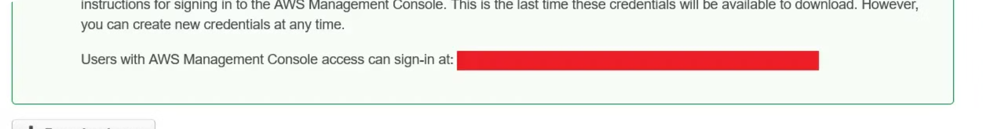
Setting up an S3 bucket for original images
Create an S3 Bucket
1
The first step is to create an S3 (Simple Storage Service) bucket in your AWS account. This bucket will serve as the repository for your original, unmodified images that will trigger the image resizing process.
2
Configure Bucket Settings
Once the bucket is created, you'll need to configure its settings to enable the S3 event that will trigger the Lambda function. This includes setting the appropriate permissions and events to monitor for new object uploads.
Secure the Bucket
3
It's important to ensure the S3 bucket is properly secured to protect your original images. This may involve setting up access control lists, bucket policies, or enabling server-side encryption to prevent unauthorized access.

Slide 4




Configuring an S3 bucket event to trigger the Lambda function
Create an S3 Bucket
1
Set up an S3 bucket to store the original images that will trigger the resizing process.
Enable S3 Events
2
Configure the S3 bucket to trigger an event whenever a new object is uploaded.
Associate Lambda Function
3
Link the S3 bucket event to the Lambda function that will handle the image resizing.
The key to automating the image resizing process is to set up an S3 bucket event that will trigger the Lambda function whenever a new image is uploaded. First, create an S3 bucket to store the original images. Then, enable the necessary events within the bucket's configuration to detect when a new object is added. Finally, associate the Lambda function you created earlier with the S3 bucket event so that it is automatically invoked to resize the uploaded image.

Slide 5
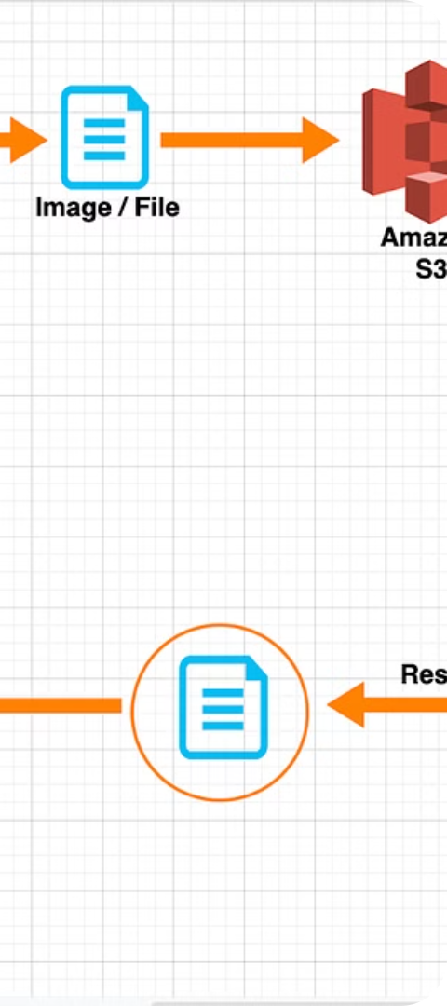



Implementing the Lambda Function using Node.js and the Sharp Library
Fetch the Original Image
The first step in the Lambda function is to fetch the original image file from the S3 bucket where the new images are being uploaded. This is done using the AWS SDK for Node.js, which provides a simple API for interacting with various AWS services, including S3.
Resize the Image with Sharp
With the original image file in hand, the Lambda function then uses the Sharp library to resize the image to multiple sizes. Sharp is a high-performance Node.js library for image processing, which can quickly and efficiently resize, crop, and manipulate images.
Store the Resized Images
After resizing the image, the Lambda function uploads the resized versions to a separate S3 bucket, where they can be easily accessed and served to users. This ensures that the original image is preserved, while the resized versions are available for use in the application.

Slide 6
Resizing the original image to multiple sizes
1
Original image
Fetch the original image from the S3 bucket
2
Resize to small
Create a smaller version of the image
3
Resize to medium
Create a medium-sized version of the image
4
Resize to large
Create a larger version of the image
With the original image fetched from the S3 bucket, the Lambda function will use the Sharp library to create multiple resized versions of the image. This includes a small, medium, and large version, each with different dimensions optimized for different use cases, such as thumbnails, preview images, and high-resolution displays. The resized images are then stored in a separate S3 bucket for later use.

Slide 7
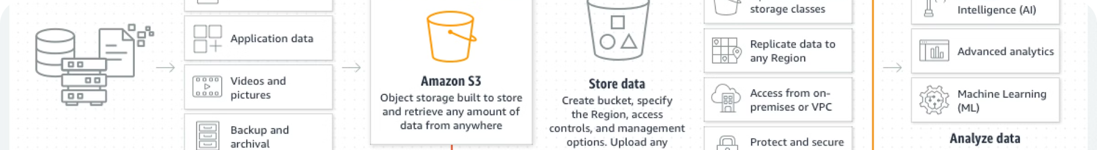



Storing the Resized Images in a Separate S3 Bucket
Create a New S3 Bucket
After resizing the original images, the next step is to create a new S3 bucket to store the resized versions. This separate bucket will help keep your file organization clean and make it easy to manage the different versions of the images.
Upload Resized Images
Once the new S3 bucket is set up, the Lambda function will upload the resized image files to this bucket. The function can use the same file naming convention or add a suffix to differentiate the original and resized versions.
Manage Access Permissions
Ensure that the proper access permissions are set for the resized image bucket. This may involve configuring IAM policies or bucket policies to control who can access and interact with the resized images.

Slide 8

Handling Errors and Edge Cases in the Lambda Function
1
Error Handling
The Lambda function should have robust error handling mechanisms to gracefully handle any exceptions that may occur during the image resizing process. This includes catching and logging errors from the Sharp library, as well as handling issues with accessing the S3 buckets or unexpected input data.
2
Retries and Backoff
In the event of a temporary failure, such as a network outage or a rate limit exception, the Lambda function should implement a retry mechanism with exponential backoff. This ensures that the resizing operation is retried a few times before the function reports a failure, minimizing the impact of transient issues.
3
Input Validation
The Lambda function should thoroughly validate the input data, such as the S3 event payload and the image file itself. This helps prevent the function from crashing or producing unexpected results when dealing with malformed or corrupted input data.

Slide 9
Benefits of the Automated Image Resizing Process
Improved Performance
Consistent Branding
Reduced Storage Costs
Scalable Solution
By automatically resizing images to the appropriate size and format, the automated process ensures faster loading times on your website or application, providing a seamless user experience.
With the ability to resize and format images consistently, you can maintain a cohesive brand identity across all your digital assets, enhancing the overall visual appeal and professionalism.
The automated resizing process allows you to optimize image sizes, reducing the storage requirements and associated costs, especially when dealing with a large volume of visual content.
As your business or website grows, the automated resizing process can easily scale to handle increasing numbers of images, ensuring your visual assets remain optimized without manual intervention.

Slide 10



Serverless Computing
Cloud Storage
Consistent, High-Quality Images
Leveraging the power of serverless computing, such as AWS Lambda, to streamline image processing.
Utilizing cloud storage solutions like Amazon S3 to efficiently manage image assets at scale.
Ensuring a seamless, visually appealing experience across your application or website.

